Slide 1
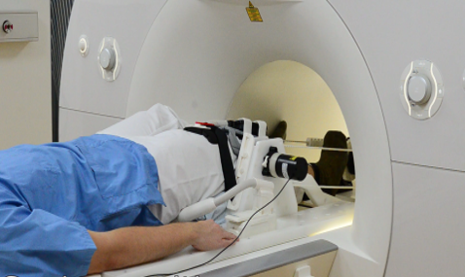
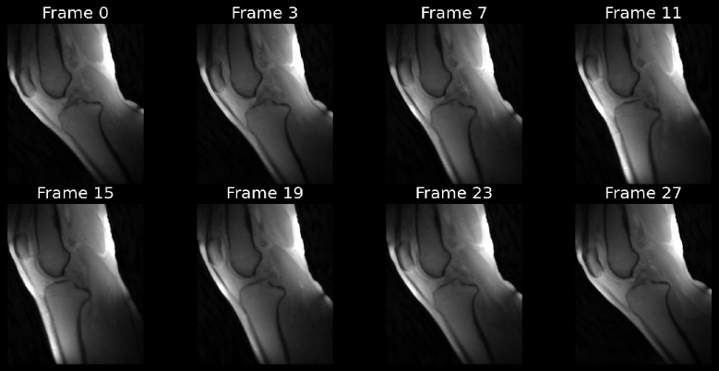
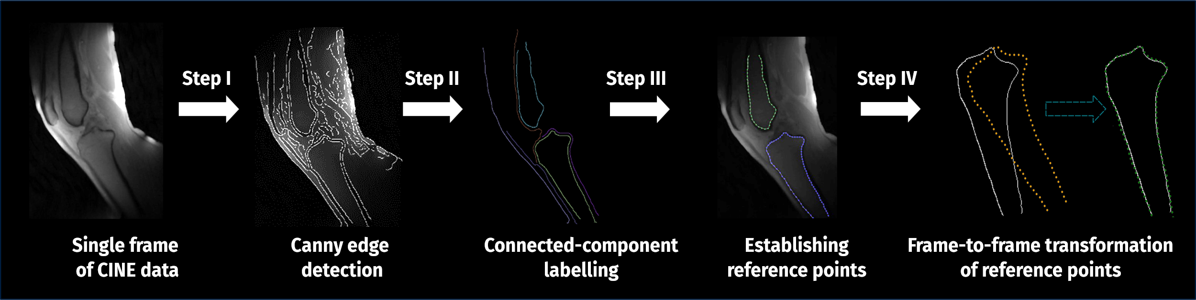
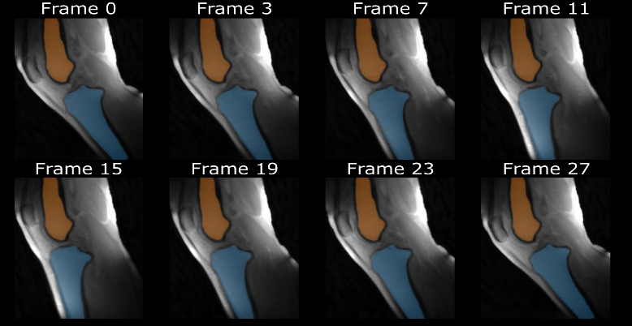

Notes:
This presentation demonstrates a semi-automated method for tracking tibiofemoral motion in dynamic MRI
Let’s begin with the motivation behind this work.

Slide 2
Motivation
Accurate assessment of osteokinematics is crucial for:
Evaluating joint function
Improving prosthetic design
Clinical diagnosis of knee pathologies
Rehabilitation monitoring
Dynamic MRI can visualize knee motion but typically require:
Time-consuming manual segmentation
Complex registration methods
High-resolution static reference scans
Notes:
Accurate osteokinematic analyses are essential for diagnosing joint dysfunctions, designing implants, and monitoring rehabilitation. While dynamic MRI provides great insight into joint motion, it is limited by time-consuming manual segmentations, reliance on static reference scans, and complex registration pipelines. Our work attempts to address these limitations

Slide 3

Knee Kinematics & Pathology
Knee osteokinematics: The motion of bones as rigid bodies around the knee joint
Bidirectional relationships: Altered kinematics can both cause and result from joint pathologies
Dynamic MRI techniques enable visualization of in vivo knee motion
Tracking Challenges:
Need for separate high-resolution reference scans
Reliance on discrete landmarks
Time-intensive manual segmentation
Notes:
Osteokinematics refers to bone motion around a joint. In the knee, altered kinematics is both a cause and consequence of joint pathologies.. While dynamic MRI offers a way to observe this motion, capturing reliable kinematic parameters from sequences like CINE MRI remains technically challenging… and that’s the gap we aim to address.

Slide 4
Goal: Semi-Automated Bone Tracking
Primary Objective
Develop and validate a semi-automated pipeline to track tibiofemoral motion from sagittal plane CINE MRI
Extract kinematic parameters during knee flexion-extension
Current Challenges
Manual segmentation is time-consuming
High-resolution reference scans add complexity
Expected Outcomes
Reduced processing time
Improved measurement consistency
Direct analysis without additional reference scans
Notes:
Our goal was to develop a semi-automated bone tracking pipeline to extract kinematic parameters from sagittal-plane CINE MRI. We aimed to reduce processing time, eliminate the need for high-resolution reference scans, and improve consistency compared to manual segmentation. Now, let me show you how the data was acquired:

Slide 5
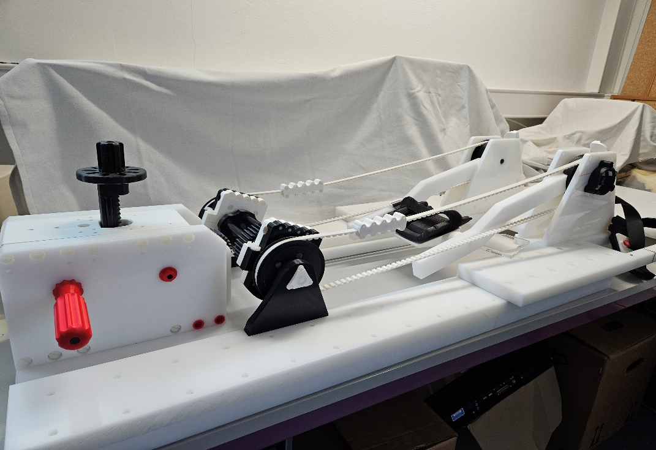

MRI-compatible knee motion device
Brisson, et al. DOI:10.1016/j.zemedi.2021.12.002
Notes:
Here you see our custom-built MRI-compatible motion device. It was specifically designed to allow controlled, repeatable flexion and extension of the knee inside the scanner. On the right, we show a subject using the device during calibration outside the bore

Slide 6
MRI-compatible knee motion device
MRI-Compatible Motion Device
Custom-designed device for controlled knee movement during MRI
Allows for cyclic flexion-extension at consistent rates
Integrated position sensor captures knee angle data
Dynamic CINE MRI
Series of images showing knee joint motion during flexion-extension
Reconstructed by sorting k-space data into discrete knee angle intervals
Enables visualization of in vivo knee movement
Brisson, et al. DOI:10.1016/j.zemedi.2021.12.002
Notes:
The motion is cyclic and guided by a metronome, producing repeatable knee flexion-extension cycles.
An integrated optical sensor records the knee angle in real time. This angular data is later used to retrospectively sort the k-space data into discrete motion frames, effectively reconstructing a dynamic CINE sequence.

Slide 7
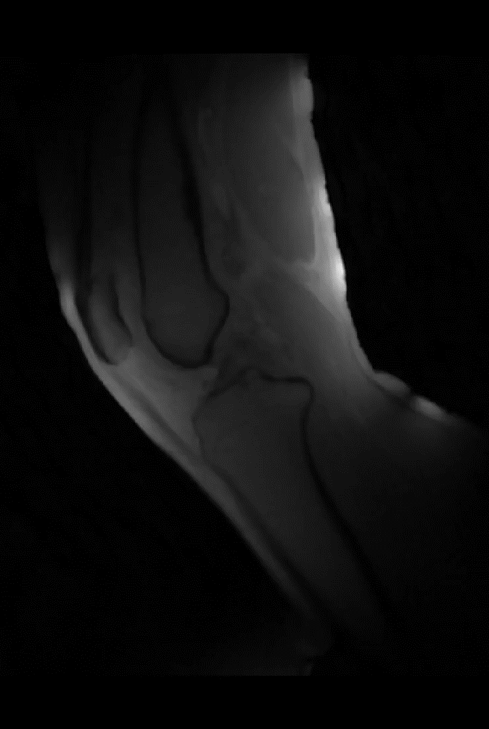
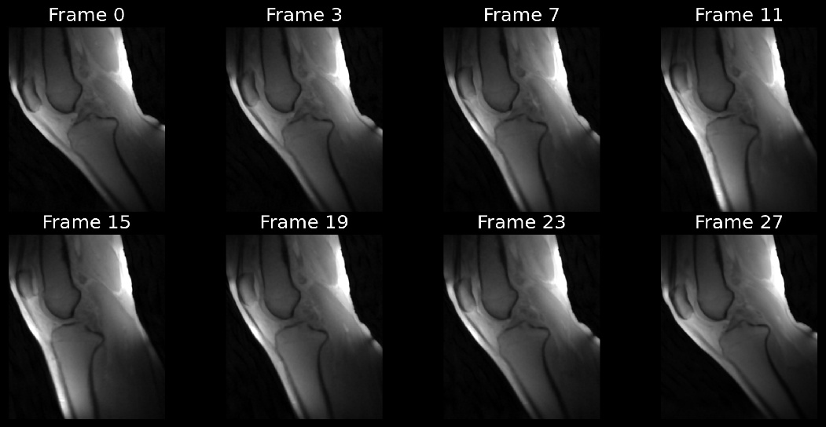
Image Acquisition and Reconstruction
Participants:
Five healthy volunteers (24-39 years)
Controlled knee flexion-extension with metronome (7.5 cycles/min)
Reconstruction
K-space data sorted into 2° knee angle windows using optical sensor data
Each CINE frame represents a specific knee angle position
MRI Parameters:
3T scanner, 2D radial golden-angle FLASH
TE/TR = 2.51/5.8 ms, flip angle 8°
176 × 176 matrix
Aleksiev, et al.
DOI: 10.1016/j.mri.2022.06.015
Notes:
We acquired dynamic MRI data from five healthy volunteers, performing controlled knee flexion-extension at 7.5 cycles per minute, guided by a metronome.
Scans were done on a 3T system using a 2D radial golden-angle FLASH sequence. Knee angles were captured in real time by an optical sensor integrated in the device, with .025 resolution.
These angular readings were used to sort the k-space data into 2-degree windows, giving us a sequence of frames where each represents a specific knee angle.
Here, you see both the individual frames and the reconstructed motion loop. This CINE series forms the basis for our subsequent tracking analysis

Slide 8
Approach
A combination of edge detection with connected-component labeling and frame-to-frame transformation optimization
Used to track bone boundaries during knee flexion-extension cycles during dynamic MRI
Four-step pipeline for continuous bone tracking across motion frames
Method validated in five healthy volunteers and compared with manual segmentation
Notes:
Now that we've established how we acquired and reconstructed the CINE MRI data, let's examine our novel tracking approach that forms the core of this work. It consists of four key steps: edge detection, component labeling, reference point selection, and frame-to-frame transformation optimization. This sequence allows us to estimate bone motion across the dynamic frames using only the segmentation done for the first frame

Slide 9
Bone Tracking Algorithm
Algorithm assumptions:
Rigid body motion in 2D sagittal plane
Three transformation parameters: two translations, one rotation
Notes:
For each frame, the algorithm computes a transformation — defined by two translations and one in-plane rotation — to map the reference contour from the first frame onto the new detected bone edges.
This transformation is optimized using nonlinear least-squares minimisation, aiming to reduce the point-to-edge distance

Slide 10
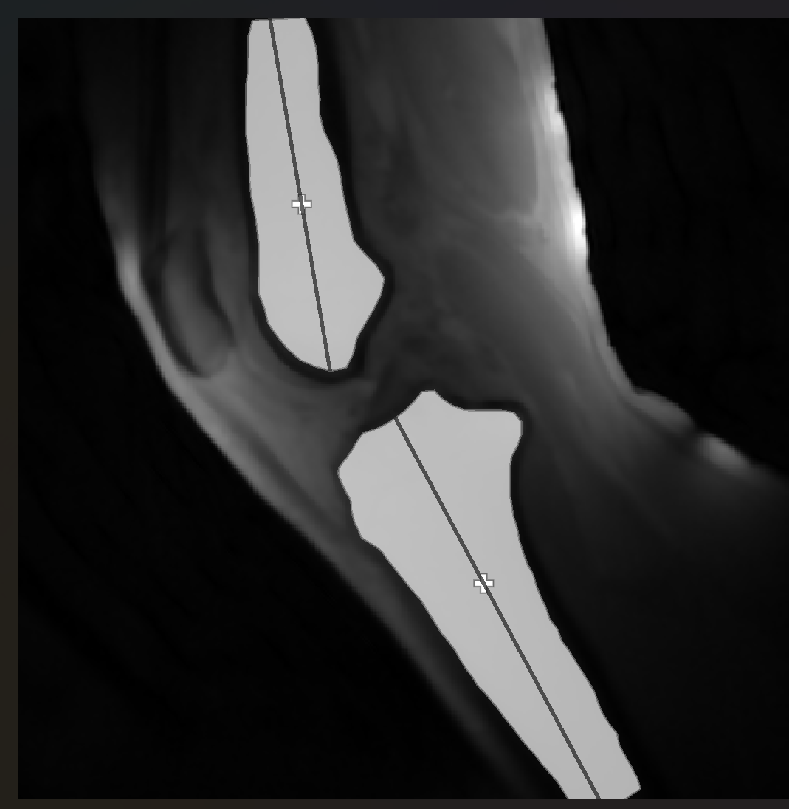
Segmentation and Kinematic Measurement
Semi-Automated Segmentation:
• Manual bone segmentation in first frame only
• Algorithm propagates segmentation to all subsequent frames
Kinematic Measurement:
• Calculated bone segment centroids
• Measured tibia-to-femur centroid displacement per frame
• Data expressed as motion cycle percentage
Validation:
• Manual segmentation of all frames for comparison
• Boundary alignment error: average distance between transformed points and detected edges
• Inter-subject displacement variability measured
Notes:
Manual segmentation is done only once, in the first frame. Using the frame-to-frame transformations, we propagate this segmentation across all frames.
We compute the geometric centroids of the femur and tibia, shown as cross symbols on the image, and track the relative displacement of the tibia with respect to the femur throughout the motion cycle.
We also validate the method by comparing it against manual segmentation for every frame

Slide 11
Results
Successful tracking of both tibial and femoral bone edges throughout the motion cycle
Alignment error: 0.40 ± 0.02 mm for both bones
Processing time: <5 minutes (semi-automated) vs. ~15 minutes (manual)
Horizontal displacement: 8-28 mm with linear trend during motion cycle
Vertical displacement: Relatively constant at ~57 mm
Improved measurement precision with smaller standard deviations compared to manual approach
Notes:
The method successfully tracked both bones across the entire motion cycle.
The mean boundary alignment error was just 0.40 millimeters. Processing time per dataset dropped from around 15 minutes manually to under 5 minutes with our pipeline.
Horizontal displacement ranged from 8 to 28 mm, while vertical displacement remained stable at around 57 mm

Slide 12

Bone Tracking Visualization
Notes:
Here you can see how the segmentation is propagated over time. The coloured overlays show the tibia and femur contours as they move together through the motion cycle

Slide 13
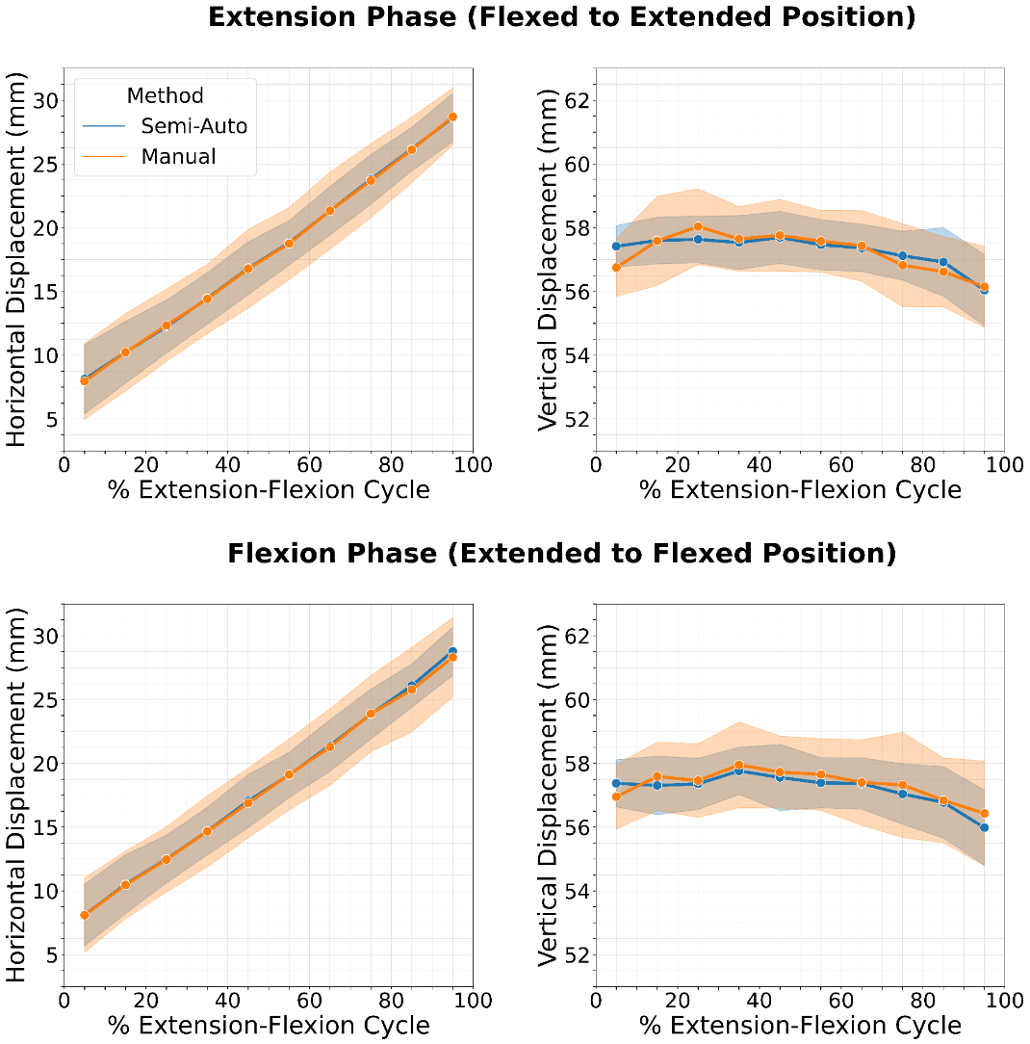
Results and Discussion: Relative Bone Displacement
Quantitative Results
Alignment Error: 0.40 ± 0.02 mm (average for both bones)
Processing Time: <5 minutes (semi-automated) vs. ~15 minutes (manual)
Horizontal Displacement: 8-28 mm (linear trend during motion cycle)
Vertical Displacement: Relatively constant at ~57 mm
Measurement Precision
Horizontal Displacement SDs:
Semi-automated: 1.7–2.7 mm
Manual: 2.2–3.3 mm
Vertical Displacement SDs:
Semi-automated: 0.7–1.2 mm
Manual: 0.9–1.7 mm
Notes:
We compared manual and semi-automated methods for both horizontal and vertical displacement.
While both approaches captured the same motion patterns, the semi-automated method yielded lower standard deviations, as can be seen in the graph.

Slide 14
Results and Discussion: Relative Bone Displacement
Key Findings
Semi-automated method shows consistently lower variability
Both methods capture similar motion patterns
Semi-automated tracking provides more consistent measurements
67% reduction in processing time per dataset
Notes:
These results show that our semi-automated method not only reproduces the expected motion trends but does so with lower variability than manual segmentation.
In both directions, the standard deviations were smaller, indicating more consistent measurements across subjects.

Slide 15
Impact and Conclusion
Technical Advantages
Works directly on dynamic MRI without reference scans
Uses complete bone contour for robust tracking versus landmark methods
Maintains precision while reducing processing time
Simplifies workflow for faster acquisition and analysis
Clinical & Research Value
Enables study of abnormal knee mechanics
Applicable for pathological kinematics analysis
Allows efficient joint function monitoring
Supports larger studies through reduced processing time
Conclusion
Novel semi-automated tracking method validated for 2D sagittal CINE MRI
Achieved 0.40 ± 0.02 mm alignment error with 67% faster processing
Improved consistency with smaller standard deviations
Suitable for both research and potential clinical applications
Notes:
To conclude, this technique enables direct analysis of dynamic MRI without requiring static reference scans.
It leverages full bone contours instead of landmarks, streamlining the workflow and improving reproducibility.
The method is well-suited for larger studies or clinical applications, especially in conditions affecting knee mechanics. Future developments could include extending this approach to 3D tracking instead of a single-slice.

Slide 16

Acknowledgment
This work was supported by the German Research Foundation (Deutsche Forschungsgemeinschaft; KR 4783/2-1, BR 6698/1-1).
Notes:
We gratefully acknowledge funding support from the German Research Foundation.

